Slide 1
Underrated
Nashorn Javascript
Presented by Stephen Russett
@stephenrussett
Github: StephenOTT

Slide 2
Underrated:
Nashorn Javascript Engine
Add JS to your Java apps
Using JS and Java…
Polyglot Vert.x
Project Es4x and Node/NPM
Automation/BPM and JS
Enterprises, Government, and all those difficult app environments
Wrong?: Execute Javascript on the JVM
Notes:
https://static3.fjcdn.com/comments/Bill+burr+in+my+opinion+is+one+of+the+most+_6520d3c51e1c7152bc1a945e9fc10e08.jpg

Slide 3
Nashorn Javascript Engine
Nashorn introduced in Java 8 to replace Rhino engine
(Nashorn in German means Rhino)
Use as a command line scripting interface or embed it
My point:
not to replace V8 / node.
leverage the JVM capabilities if and when required, and still get to use scripting
Netflix Nashorn use case from 2015:
Dynamic Report Editing
https://www.infoq.com/news/2015/01/nashorn-at-netflix
2014
Javascript -> bytecode -> JVM
Yes.. It’s not “as fast as V8”!
Check out the following for more benchmarks:
https://lemnik.wordpress.com/2017/08/07/is-nashorn-jvm-faster-than-node-v8/
Notes:
https://ariya.io/2014/03/nashorn-the-new-rhino-on-the-block
https://www.oracle.com/corporate/features/nashorn-javascript-engine-jdk9.html
https://wiki.openjdk.java.net/display/Nashorn/Nashorn+extensions
https://i.ytimg.com/vi/rksKvZoUCPQ/mqdefault.jpg

Slide 4
Add JS to your Java App
ScriptEngine nashornEngine = new ScriptEngineManager().getEngineByName("nashorn");
String jsScript = inputStreamAsString(someJsFile);
Bindings bindings = nashornEngine.createBindings();
bindings.put("personInstance", personClass.getBioData());
Object scriptResult = nashornEngine.eval(jsScript, bindings);
Done

Slide 5
Little more full example:
// Create the Nashorn ScriptEngine
ScriptEngine nashornEngine = new ScriptEngineManager().getEngineByName("nashorn");
// Get your script from a file
String jsScript = inputStreamAsString(resource);
// Expose/Bind Java variables/objects into the Javascript:
Bindings bindings = nashornEngine.createBindings();
bindings.put("someVariable", someVariable);
bindings.put("someVariable2", someClass.getSomeObject());
// eval the script and get the specific result/what was returned by the engine
Object scriptResult = nashornEngine.eval(jsScript, bindings);
// Or just eval and not worry about the return
nashornEngine.eval(jsScript, bindings);
// Or can can call specific functions:
String functionName = 'someFunctionName'
CompiledScript nashornCompiled = ((Compilable) nashornEngine).compile(jsScript);
((Invocable) nashornEngine).invokeFunction(functionName); // Supports arguments as well

Slide 6
Node, ES6, Detroit
Nashorn is not 100% ES6 or Node library compatible.
Lots of history on integrations and compatibility discussions.
Look it up if interested: Project Avatar, etc
Diminishing returns as more libs become incompatible with Nashorn.
Java 9 adds ES6 features: symbols, let, const, iterator, collections Map and Set, Templates, Binary and octal numbers
OpenJDK Project Detroit aims to add V8 into JVM as a “ScriptEngine”… but it just recently started…
The answer is not always: “replace it with Node”
Notes:
https://spin.atomicobject.com/wp-content/uploads/20171230095148/es6-nodejs.jpg

Slide 7
Some Additional Nashorn features
// import lodash from CDN
load('https://cdnjs.cloudflare.com/ajax/libs/lodash.js/4.17.10/lodash.min.js')
// Print to stdout
var System = Java.type("java.lang.System")
System.out.println('this prints to stdout')
// or just
print('this prints to stdout')
// Working with JSON and returning something Java can deal with:
// myJson, if returned to the Java side would be available as a Java Map
var myJson = Java.asJSONCompatible({
x: 343,
y: 'hello',
z: [ 2, 4, 5]
});
// Java Objects and Arrays, Maps and Collections
// are traversable as regular JSON in JS
var myValue = someJavaMap['someKey']
// Pre es6 support, there was extra loop helpers:
for each (i in someArray) {
print(i);
}

Slide 8
Freemarker Example with Import Scopes
/**
* Evaluate/Render a FreeMarker template
*
* @param string content The string content of a FreeMarker template.
* @param string object The KeyValue object/JSON object for placeholder bindings.
* @return string The rendered FreeMarker template.
*/
function renderFreeMarkerTemplate(content, placeholderValues)
{
var ScriptEngine = new JavaImporter(javax.script);
with (ScriptEngine) {
var manager = new ScriptEngineManager();
var engine = manager.getEngineByName('freemarker');
var bindings = engine.createBindings();
bindings.put('placeholders', placeholderValues);
var rendered = engine.eval(content, bindings);
return rendered;
}
}
var placeholderValues = {
"firstName": "John",
"lastName": "Smith"
}
var renderedTemplate = renderFreeMarkerTemplate(content, placeholderValues);
renderedTemplate.toString();

Slide 9
/**
* Evaluate/Render a FreeMarker template
*
* @param string content The string content of a FreeMarker template.
* @param string object The KeyValue object/JSON object for placeholder bindings.
* @return string The rendered FreeMarker template.
*/
function renderFreeMarkerTemplate(content, placeholderValues)
{
var ScriptEngine = new JavaImporter(javax.script);
with (ScriptEngine) {
var manager = new ScriptEngineManager();
var engine = manager.getEngineByName('freemarker');
var bindings = engine.createBindings();
bindings.put('placeholders', placeholderValues);
var rendered = engine.eval(content, bindings);
return rendered;
}
}
var placeholderValues = {
"firstName": "John",
"lastName": "Smith"
}
var renderedTemplate = renderFreeMarkerTemplate(content, placeholderValues);
renderedTemplate.toString();

Slide 10
Polyglot Vert.x
A Eclipse project
Vertx is a polyglot-reactive runtime that runs on the JVM.
Build interoperable code on the JVM that will execute:
Java
Javascript
Groovy
Ruby
Ceylon
Kotlin
Scala
They are telling me we can take this scripting even further
Btw.. It adds addition NPM and Node support on top of Nashorn
Notes:
http://www.laughspin.com/wordpress/wp-content/uploads/Bill-Burr-700.jpg
https://upload.wikimedia.org/wikipedia/commons/thumb/c/c4/Vert.x_Logo.svg/1200px-Vert.x_Logo.svg.png

Slide 11
Nashron vs V8
Look.. It can perform for most use cases…
2014
But with obvious asterisks
And again, we are not trying to replace Node…
Vertx Javascript (Nashorn)* vs Node* ->
Higher is better
Deploy Multiple Languages within the app:
function deployVerticles() {
vertx.deployVerticle('verticles/verticle1.js’)
vertx.deployVerticle('verticles/verticle2.gvy’)
vertx.deployVerticle('verticles/someWorker1.rb')
}
https://www.cubrid.org/blog/inside-vertx-comparison-with-nodejs
Notes:
https://www.cubrid.org/blog/inside-vertx-comparison-with-nodejs

Slide 12
Nashorn + Java Drools + Vertx Web Service
// get a reference from Java to the JavaScript runtime
const DroolsHelper = Java.type('drools.DroolsHelper');
// get a drools engine instance
const engine = DroolsHelper.load(vertx.fileSystem().readFileBlocking("drools/rules.drl"));
app.get('/greetings').handler(function (ctx) {
// create a greetings message
var greeting = DroolsHelper.createGreeting('Hello World!', function () {
// when a match happens you should see this message
console.log('Greetings from Drools!');
});
// run the engine
engine.insert(greeting);
engine.fireAllRules();
// complete the HTTP response
ctx.response().end();
});
Notes:
https://opensource.com/article/18/4/benefits-javascript-vertx

Slide 13
Vertx + es4x + NPM
// https://github.com/reactiverse/es4x
// terminal:
mkdir my-app
cd my-app
npm init -y
npm add vertx-scripts --save-dev
npm add @vertx/unit --save-dev
npm add @vertx/core --save-prod
// package.json:
{
...
"scripts": {
"postinstall": "vertx-scripts init",
"test": "vertx-scripts launcher test -v",
"start": "vertx-scripts launcher run",
"package": "vertx-scripts package"
},
...
}
// index.js:
/// <reference types="@vertx/core/runtime" />
// @ts-check
vertx
.createHttpServer()
.requestHandler(function (req) {
req.response().end("Hello!");
})
.listen(8080);
console.log('Server listening at: http://localhost:8080/');
// index.test.js:
import { TestSuite } from '@vertx/unit';
const suite = TestSuite.create("the_test_suite");
suite.test("my_test_case", function (context) {
var s = "value";
context.assertEquals("value", s);
});
suite.run();
Notes:
https://github.com/reactiverse/es4x

Slide 14
// terminal:
mkdir my-app
cd my-app
npm init -y
npm add vertx-scripts --save-dev
npm add @vertx/unit --save-dev
npm add @vertx/core --save-prod
// package.json:
{
...
"scripts": {
"postinstall": "vertx-scripts init",
"test": "vertx-scripts launcher test -v",
"start": "vertx-scripts launcher run",
"package": "vertx-scripts package"
},
...
}
// index.js:
/// <reference types="@vertx/core/runtime" />
// @ts-check
vertx
.createHttpServer()
.requestHandler(function (req) {
req.response().end("Hello!");
})
.listen(8080);
console.log('Server listening at: http://localhost:8080/');
// index.test.js:
import { TestSuite } from '@vertx/unit';
const suite = TestSuite.create("the_test_suite");
suite.test("my_test_case", function (context) {
var s = "value";
context.assertEquals("value", s);
});
suite.run();

Slide 15
Start and Package your Node/NPM
npm start -> Run the App
Starts the JVM and executes the Vertx application
npm package -> builds a executable Jar that can be executed on your JVM
The “Magic” is it uses NPM as your development interface, but under the hood, its executing a Java build
https://github.com/reactiverse/es4x

Slide 16
Lets put it all together: Java BPMs and Javascript
Process Automation: Java dominated, not really any OSS non-Java contenders
More and more used for Microservices Orchestration:
Hmmmm, not sure this is for me…
Me: I don’t want to write JARs and “Java” for stuff… My technical business staff need to be able to write scripts!!
The Devs: I don’t want to write all of the spaghetti stupid business logic for every customer/client…

Slide 17
Use Case Examples!
Data Encryption
API Form Validations Scripting
Unit Testing / Writing Tests as Script
Incident Handlers
Extend the Camunda API with Vertx: Camunda Plugin and SpringBoot
BPMN Documentation Generator: Camunda BPMN Model Library, Freemarker and Vertx

Slide 18
Data Encryption
load('classpath:rsaEncrypt.js')
var messageToSeal = 'This message is to be hidden'
var sealedObject = rsaSeal(messageToSeal, PUBLIC_KEY)
execution.setVariable('sealed_object', sealedObject)
Encrypt / Seal
rsaEncrypt.js is a set of functions that call Java encryption classes
load('classpath:rsaEncrypt.js’)
var sealedObject = execution.getVariable('sealed_object’)
var unsealedObject = rsaUnseal(sealedObject, PRIVATE_KEY)
execution.setVariable('unsealed_object', unsealedObject)
Decrypt / Unseal
Public and Private keys locations are set in the ENV vars, but of course there are other JS functions in “rsaEncrypt.js” to set your own

Slide 19
API Form Validations Scripting
Camunda BPM
Variables that cannot be modified
{ ...
"variables": {
"age": {
"value": 25,
"type": "Integer"
},
"priority": {
"value": 10,
"type": "Integer"
}
}, ...
}
POST JSON Payload ->

Slide 20
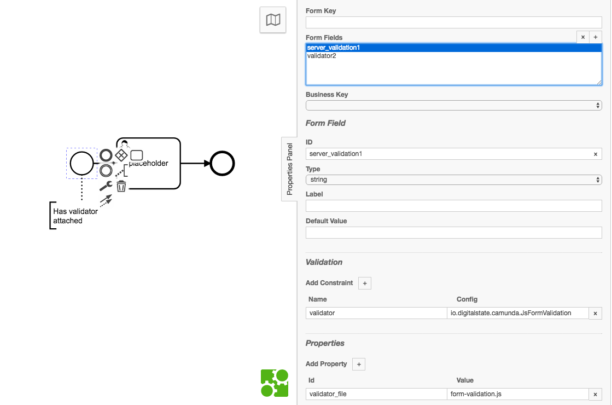

Slide 21
load('classpath:validationResult.js')
load('classpath:validate.min.js')
var JSONObject = Java.type('org.camunda.bpm.engine.impl.util.json.JSONObject')
var jsonSubmission = JSON.parse(new JSONObject(submissionValues).toString())
// Validate.js Constraints
function getConstraints() {
var constraints = {
age: {
presence: true,
numericality: {
onlyInteger: true,
greaterThan: 18,
lessThanOrEqualTo: 125,
}
}
};
return constraints
}
// List of fields that are not allowed to be changed
function bannedFields(){
// could also be loaded from another location (like a yaml or json file)
return [
"risk",
"owner",
"master_field",
"current_state",
"flagged",
"priority"
]
}
// Check if the submission has any of the banned fields
function checkForBannedFields(submission, bannedFields) {
// Loop through list of banned fields (nashorn loop)
for each (var field in bannedFields){
var hasBannedField = validate.contains(submission, field)
// if a banned field was found then return true:
if (hasBannedField == true) {
return true
}
}
// If no banned fields were found:
return false
}
// if there is a banned field:
if (checkForBannedFields(jsonSubmission, bannedFields())){
validationResult(false, {
"detail": "VALIDATE.JS",
"message": 'Submission contains a banned field: ' + JSON.stringify(bannedFields())
}
)
// If no banned fields were found:
} else {
// If no banned fields then continue:
// Run Validations against Validate.js
var validation = validate(jsonSubmission, getConstraints())
if (validation === undefined) {
validationResult(true)
} else {
validationResult(false, {
"detail": "VALIDATE.JS",
"message": JSON.stringify(validation)
}
)
}
}
Regular JS with Validate.js

Slide 22
load('classpath:validationResult.js')
load('classpath:validate.min.js')
var JSONObject = Java.type('org.camunda.bpm.engine.impl.util.json.JSONObject')
var jsonSubmission = JSON.parse(new JSONObject(submissionValues).toString())
// Validate.js Constraints
function getConstraints() {
var constraints = {
age: {
presence: true,
numericality: {
onlyInteger: true,
greaterThan: 18,
lessThanOrEqualTo: 125,
}
}
};
return constraints
}
// List of fields that are not allowed to be changed
function bannedFields(){
// could also be loaded from another location (like a yaml or json file)
return [
"risk",
"owner",
"master_field",
"current_state",
"flagged",
"priority"
]
}
// Check if the submission has any of the banned fields
function checkForBannedFields(submission, bannedFields) {
// Loop through list of banned fields (nashorn loop)
for each (var field in bannedFields){
var hasBannedField = validate.contains(submission, field)
// if a banned field was found then return true:
if (hasBannedField == true) {
return true
}
}
// If no banned fields were found:
return false
}
// if there is a banned field:
if (checkForBannedFields(jsonSubmission, bannedFields())){
validationResult(false, {
"detail": "VALIDATE.JS",
"message": 'Submission contains a banned field: ' + JSON.stringify(bannedFields())
}
)
// If no banned fields were found:
} else {
// If no banned fields then continue:
// Run Validations against Validate.js
var validation = validate(jsonSubmission, getConstraints())
if (validation === undefined) {
validationResult(true)
} else {
validationResult(false, {
"detail": "VALIDATE.JS",
"message": JSON.stringify(validation)
}
)
}
}

Slide 23
load('classpath:validationResult.js')
load('classpath:validate.min.js')
var JSONObject = Java.type('org.camunda.bpm.engine.impl.util.json.JSONObject')
var jsonSubmission = JSON.parse(new JSONObject(submissionValues).toString())
// Validate.js Constraints
function getConstraints() {
var constraints = {
age: {
presence: true,
numericality: {
onlyInteger: true,
greaterThan: 18,
lessThanOrEqualTo: 125,
}
}
};
return constraints
}
// List of fields that are not allowed to be changed
function bannedFields(){
// could also be loaded from another location (like a yaml or json file)
return [
"risk",
"owner",
"master_field",
"current_state",
"flagged",
"priority"
]
}
// Check if the submission has any of the banned fields
function checkForBannedFields(submission, bannedFields) {
// Loop through list of banned fields (nashorn loop)
for each (var field in bannedFields){
var hasBannedField = validate.contains(submission, field)
// if a banned field was found then return true:
if (hasBannedField == true) {
return true
}
}
// If no banned fields were found:
return false
}
// if there is a banned field:
if (checkForBannedFields(jsonSubmission, bannedFields())){
validationResult(false, {
"detail": "VALIDATE.JS",
"message": 'Submission contains a banned field: ' + JSON.stringify(bannedFields())
}
)
// If no banned fields were found:
} else {
// If no banned fields then continue:
// Run Validations against Validate.js
var validation = validate(jsonSubmission, getConstraints())
if (validation === undefined) {
validationResult(true)
} else {
validationResult(false, {
"detail": "VALIDATE.JS",
"message": JSON.stringify(validation)
}
)
}
}

Slide 24
Validation Result helper
function validationResult(result, validationError) {
if (result != true){
result = false
}
if (result == true){
return Java.asJSONCompatible({
"result": true
})
} else {
return Java.asJSONCompatible({
"result": false,
"validation_error": {
"detail": validationError.detail,
"message": validationError.message
}
})
}
}

Slide 25
Unit Testing / Writing Tests as Script
Spock Unit Testing (Groovy based)
Eval Javascript
Call specific functions from the Eval
Mock the Java classes
Use a more business friendly language
Image: https://tech.smartling.com/the-spock-epic-part-3-the-undiscovered-groovy-4b744815aa21

Slide 26
Spock Unit Testing of Nashorn JS
@Shared ScriptEngine engine = new ScriptEngineManager().getEngineByName('nashorn');
//
// gateway_decision.js
//
def 'Nashorn: gateway_decision.js'(int number_dataTable, boolean gatewayDecision) {
setup:_ 'Setup Mocks and binding'
def execution = Mock(DelegateExecution)
execution.getVariable('number') >> number_dataTable
engine.put('execution', execution)
when:_ 'Execute Script'
// Gets the specific .js script as text/string.
def source = this.class.getResource('bpmn/end-to-end/gateway_decision.js').text
def evalResult = engine.eval(source);
then:_ 'Gateway Decision matches expection'
assertThat 'The script retuned the exepected result',
evalResult == gatewayDecision
println "Script Response: ${evalResult}"
println "DataTable Expected Response: ${gatewayDecision}"
where:
number_dataTable || gatewayDecision
-1 || false
0 || false
1 || false
2 || false
3 || false
4 || false
5 || true
6 || true
7 || true
8 || true
9 || true
10 || true
11 || false
}

Slide 27
@Shared ScriptEngine engine = new ScriptEngineManager().getEngineByName('nashorn');
//
// gateway_decision.js
//
def 'Nashorn: gateway_decision.js'(int number_dataTable, boolean gatewayDecision) {
setup:_ 'Setup Mocks and binding'
def execution = Mock(DelegateExecution)
execution.getVariable('number') >> number_dataTable
engine.put('execution', execution)
when:_ 'Execute Script'
// Gets the specific .js script as text/string.
def source = this.class.getResource('bpmn/end-to-end/gateway_decision.js').text
def evalResult = engine.eval(source);
then:_ 'Gateway Decision matches expection'
assertThat 'The script retuned the exepected result',
evalResult == gatewayDecision
println "Script Response: ${evalResult}"
println "DataTable Expected Response: ${gatewayDecision}"
where:
number_dataTable || gatewayDecision
-1 || false
0 || false
1 || false
2 || false
3 || false
4 || false
5 || true
6 || true
7 || true
8 || true
9 || true
10 || true
11 || false
}

Slide 28
Incident Handlers
Something goes wrong: a “Incident is created”
“Every time in all processes, if something goes wrong, I want to Do XYZ”
“notify by email when XYZ occurs/incident occurs”
Multiple functions are possible:
Handle Incident
Resolve Incident
Delete Incident
Additional data about the incident
is valuable during incident
scripting: Use Bindings!
Image: https://xkcd.com/838/

Slide 29
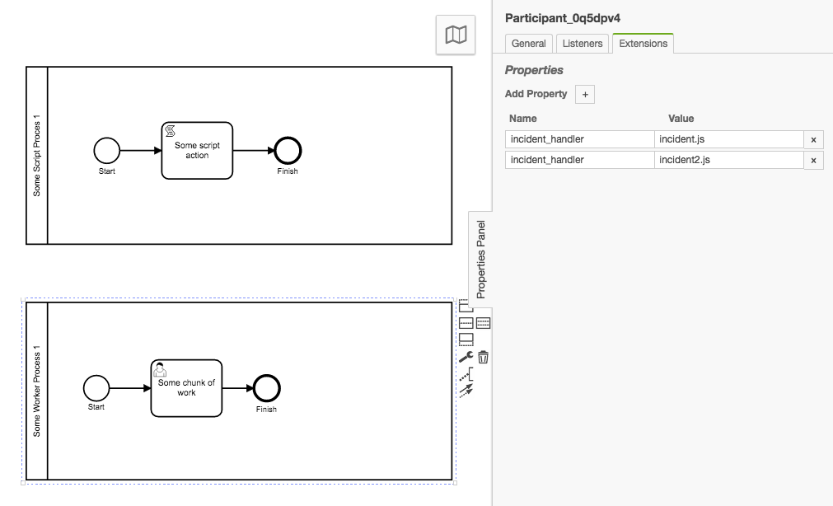

Slide 30
Invoking a specific function
var system = java.lang.System
function handleIncident(){
system.out.println("This is a handleIncident Function Message: ");
system.out.println(incidentContext.getProcessDefinitionId())
system.out.println(incidentMessage)
}
function resolveIncident(){
system.out.println("This is executed when the incident was resolved");
}
function deleteIncident(){
system.out.println("This is executed when the incident was deleted");
}
// incidentContext.getProcessDefinitionId()
// incidentContext.getActivityId()
// incidentContext.getExecutionId()
// incidentContext.getConfiguration()
// incidentContext.getTenantId()
// incidentContext.getJobDefinitionId()
// execution variable is available
// incidentMessage is also available
// example output
// camunda_1 | This is a message we wanted to see!!
// camunda_1 | myProcess-incident1:4:2c726ce0-4b60-11e8-8225-0242ac130002
// camunda_1 | ENGINE-09027 Exception while resolving duedate 'dog': Invalid format: "dog"

Slide 31
var system = java.lang.System
function handleIncident(){
system.out.println("This is a handleIncident Function Message: ");
system.out.println(incidentContext.getProcessDefinitionId())
system.out.println(incidentMessage)
}
function resolveIncident(){
system.out.println("This is executed when the incident was resolved");
}
function deleteIncident(){
system.out.println("This is executed when the incident was deleted");
}
// incidentContext.getProcessDefinitionId()
// incidentContext.getActivityId()
// incidentContext.getExecutionId()
// incidentContext.getConfiguration()
// incidentContext.getTenantId()
// incidentContext.getJobDefinitionId()
// execution variable is available
// incidentMessage is also available
// example output
// camunda_1 | This is a message we wanted to see!!
// camunda_1 | myProcess-incident1:4:2c726ce0-4b60-11e8-8225-0242ac130002
// camunda_1 | ENGINE-09027 Exception while resolving duedate 'dog': Invalid format: "dog"

Slide 32
Extend the Camunda API with Vertx: Camunda Plugin and Spring Boot
With Tomcat or whichever container or with Springboot…
Don’t want to write Jax-rs JARs and deploy.
Endpoints specific to a Process instance (complete a task through email link)
Technical staff can add new Vertx Verticles as they see fit.

Slide 34
BPMN Documentation Generator: Camunda BPMN Model Library, Freemarker and Vertx
function instanceClass(type){
var bpmnInstanceClass = Java.type('org.camunda.bpm.model.bpmn.instance.' + type).class
return bpmnInstanceClass
}
<#list tasks_>
Elements:
<#items as task>
Task Type:
${task.getElementType().getTypeName()}
Task Name:
${task.getName()}
Custom Attributes:
<#list task.getExtensionElements().getElementsQuery().filterByType(extensionElements_).singleResult().getCamundaProperties()>
<#items as extensionElement>
Attribute:
Key: ${extensionElement.getCamundaName()}
Value: ${extensionElement.getCamundaValue()}
</#items>
</#list>
--------------------
</#items>
</#list>
Freemarker Template

Slide 35
<#list tasks_>
Elements:
<#items as task>
Task Type:
${task.getElementType().getTypeName()}
Task Name:
${task.getName()}
Custom Attributes:
<#list task.getExtensionElements().getElementsQuery().filterByType(extensionElements_).singleResult().getCamundaProperties()>
<#items as extensionElement>
Attribute:
Key: ${extensionElement.getCamundaName()}
Value: ${extensionElement.getCamundaValue()}
</#items>
</#list>
--------------------
</#items>
</#list>

Slide 36
<#list tasks_>
Elements:
<#items as task>
Task Type:
${task.getElementType().getTypeName()}
Task Name:
${task.getName()}
Custom Attributes:
<#list task.getExtensionElements().getElementsQuery().filterByType(extensionElements_).singleResult().getCamundaProperties()>
<#items as extensionElement>
Attribute:
Key: ${extensionElement.getCamundaName()}
Value: ${extensionElement.getCamundaValue()}
</#items>
</#list>
--------------------
</#items>
</#list>

Slide 37
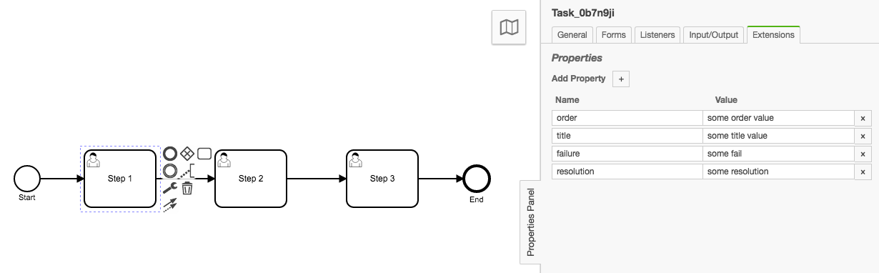

Slide 38
Freemarker Template output
Elements:
Task Type:
userTask
Task Name:
Step 1
Custom Attributes:
Attribute:
Key: order
Value: some order value
Attribute:
Key: title
Value: some title value
Attribute:
Key: failure
Value: some fail
Attribute:
Key: resolution
Value: some resolution
--------------------
Task Type:
userTask

Slide 39
Elements:
Task Type:
userTask
Task Name:
Step 1
Custom Attributes:
Attribute:
Key: order
Value: some order value
Attribute:
Key: title
Value: some title value
Attribute:
Key: failure
Value: some fail
Attribute:
Key: resolution
Value: some resolution
--------------------
Task Type:
userTask

Slide 40
Enterprises, governments and those difficult app environments
Large Niche for Nashorn/JVM JS execution
Dynamic, runtime extensions of your Java applications.
Add new functionality to applications that the technical business users want to modify. Netflix example.
Alternative to: “Why not just rebuild/rewrite in node?...”
Vertx: Pick the language best suited without the overhead
Reaction they give you when starting the conversation about JS and Java

Slide 41
Enterprises, governments and those difficult app environments
enterprise, Gov, or whatever “difficult env: already using Java?
There is still options to use Javascript within the approved JVM.
Enable technical business staff to write the scripting layer.
It’s Java.. But it’s also JS.
Reaction they give you when starting the conversation about JS and Java
You: Stay in the Pocket.
You got this.
Stay with me..

Slide 42
Enterprises, governments and those difficult app environments
Reaction they give you when starting the conversation about JS and Java
You: Stay in the Pocket.
You got this.
Stay with me..
You: When you are quickly producing functionality in that “Java App” that no one wanted to touch, recompile, deploy, etc

Slide 43
Thank you Underrated
Nashorn Javascript
Presented by Stephen Russett
@stephenrussett
Github: StephenOTT

